Slide 1
Environmental Health Impacts of European Policies for Mitigation of and Adaptation to Climate Change – a Case Study for Integrated Health Assessment Using the INTARESE/HEIMTSA Methodology
USTUTT, THL, CERTH, JRC, TNO, IOM, UBath, CUEC, ENPC, RIVM, IC, NILU, ETH-Z, UM-ICIS, INERIS, met.no, MSC-East, UU, UoM, AUTH

Slide 2
Common Case Study Overview
Aim: to demonstrate the application of the INTARESE/HEIMTSA methodology for integrated environmental health impact assessment by carrying out an assessment of environmental health impacts of high-level, cross-cutting policy issues at EU level
Main Tasks:
Issue Framing Design Execution Appraisal

Slide 3
Issue Framing:
Main criteria for selecting policies and measures for mitigation of and adaptation to climate change:
reduction of CO2_{eq}. emissions (mitigation)
reduction of climate change impacts (adaptation)
costs and distribution of costs (who pays how much)
However:
Relevant side benefits or side detriments might exist, especially secondary environmental health impacts.
Examples: production and burning of biomass, renewables and nuclear instead of coal and gas for electricity production, lower air exchange rate indoors, wood stoves indoors…
These side effects should be taken into account, if relevant!

Slide 4
The Policy Question:
What are the (negative or positive) impacts of
a) EU mitigation options (policies and resulting measures) to reduce greenhouse gas emissions
b) EU adaptation options (policies and resulting measures) to reduce impacts of climate change
on human health worldwide?

Slide 5
Scoping:
Methods used:
Systematic collection of policies and measures for mitigation of greenhouse gases and adaptation to climate change; use of EU and national programs and studies
Brainstorming about the relevant health impacts occuring when implementing these options and the relevant impact pathways
Documentation of these pathways and the relation between them in causal diagrams

Slide 6
Land use planning
Issue framing: indoor air
Transport policy
Land use patterns
Road traffic
Long-range transport
Emissions controls
Long-range transport
Industry
Respiratory disease
Ambient concentrations
Local emissions
Meteorology (wind speed, wind direction, air pressure etc)
Cardio-vascular disease
Exposures (PM, Nox, CO, VOCs, bioaerosols etc)
Pollutant ingress
Room volume
Indoor concentrations
Cancer
Site conditions
Indoor emissions
Pregnancy outcome
Air exchange rate
Building design
Cooking
Heating
Ventilation status
Time activity patterns
Furnishings
Building regulations
Energy status
Energy policies

Slide 7
Screening
Estimation of the importance (order of magnitude) of health impacts from a stressor by
a quantitative health impact assessment with simplified methods and models and rough assumptions or
a qualitative expert judgment or semi-quantitative analysis of the importance of an issue

Slide 8
Example for Screening Results
Energy Policies (mDALYs / t CO₂ avoided):
  Electricity production with more wind replacing coal : - 0.4
  Coal fired plants with CCS: -0.1
Transport Policies (mDALYs / t CO₂ avoided):
  Electric cars : -0,2
  City toll in all European metropolitan areas -0,1
An increase of DALYs is expected for
biomass use: e.g. wood in small furnaces
better insulation of houses (increase of mould, env. tobacco smoke, radon conc.)
1 mDALY = one thousandths of a DALY; 1 DALY = 1 disability adjusted life year

Slide 9
Policies and Measures Included in the Climate Scenario
Energy supply: more wind, biomass (incl. wood stoves), natural gas, solar, nuclear, CHP (combined heat and power), CCS (carbon capture and storage)
Energy demand: more insulation, heat pumps, changed industry processes, light cars, tyres, fuel efficient engine oil, more air conditioning…
Transport: more electric, biofuels, hybrid; enhanced public transport and bicycle use; speed limits; fuel taxes, city tolls, road pricing;
Agriculture: production of energy crops, reduced consumption of red meat (beef) and milk products;
City development: greener areas and albedo change

Slide 10
Main activity areas:
Energy supply and demand
Transport
Agriculture
Waste
Buildings and Urban Development
Main Pressures causing env. health impacts:
PM₁₀, PM_{2.5}, incl. secondary PM_{x}, ozone, noise, pesticides, PCBs, dioxins/furanes, heat;
indoor: PM_{2.5}, PM₁₀, ETS, radon, mould, formaldehyde

Slide 11
The Full Chain Approach
Changes in behaviour, activity
Emission reduction and control
Stack height, spatial planning
Education, advise
Policy interventions
Medication,
prevention
Transport and transformation in air, water, soil, food
Exposure and intake modelling
Models
Scenario
develop-ment
Emission modelling
Impact modelling
Aggregation valuation
Exposure- response- relation-ships
Emis-sion factors
Meteoro-logy
Population, Diet, Time-activity
Unit values
Health impacts
Future Activities
Concentra-tion, Level, Deposition
Exposure,Dose, Intake
Emissions
Releases
DALYspdfs
costs
Damage to ecosystems, materials
Variables

Slide 12
Step 1: Scenario development
A scenario is the description of a possible, consistent future development of a system (e.g. energy/transport/agriculture/waste system)
‘Business as usual’ or reference scenario:
Activities and emission factors follow trend and include agreed policies, however no climate change mitigation measures after 2012;
Some adaptation measures included;
GHG emissions and climate change according to IPCC A1B scenario

Slide 13
Step 1: Scenario development
450 ppm or 2° scenario (climate protection scenario):
Embedded in a worldwide emission scenario aiming at not exceeding 2° temperature increase:
Reduction of EU GHG emissions by 20% 1990-2020 and 71% 1990-2050
Climate according to IPCC B1
Constraints:
Share of renewable energy on final energy consumption > 20% 2020, > 40% 2050
At least 10% biofuels in transport fuels 2020
Minimum market shares for electric and hybrid cars
Continuation of national policies of subsidizing renewable energies (e.g. PV)
Emission trading system continues: -31.5 % 2005-2020, then -1.74 % p.a.

Slide 14
General assumptions
 | 2005 | 2030 | 2050
GDP [ 10¹² €₂₀₀₇ ] | 11,7 | 17,8 | 24,4
GDP | Average annual growth 2010 - 2050: 1.7%, Regional differences among countries
Oil price [US$₂₀₀₇/bbl] | 78 | 100 | 109
Other assumptions | additional nuclear power in countries according to current national policy

Slide 15
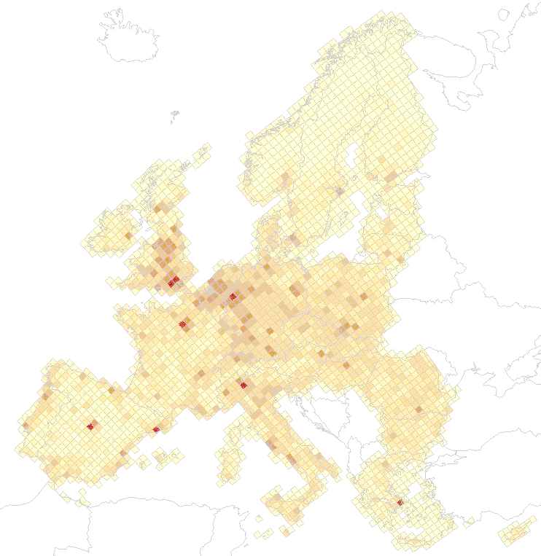
Population data (EU 30)
Available
per country / EMEP grid cell,
per subgroup (5 year age
groups and ERF-needed groups)
per CCS year
2010 | 2020 | 2030 | 2050
510 Mio. | 518 Mio. | 519 Mio. | 508 Mio.

Slide 16
Number of buildings and living space of households, transport demand for EU 25
Year | Number of buildings | Number of dwellings | Living space of dwellings
2005 | 114.9 Mio. | 197.9 Mio. | 15,856 Mio. m²
2020 | 147.2 Mio. | 260.2 Mio. | 20,502 Mio. m²
2030 | 154.4 Mio. | 273.6 Mio. | 22,041 Mio. m²
2050 | 152.0 Mio. | 259.8 Mio. | 22,320 Mio. m²
 |  | 2005 | 2030 | 2050
Passenger transport | Billion pkm | 5826 | 6742 | 6914
Freight transport | Billion tkm | 2538 | 3745 | 4117

Slide 17
Invest costs of new renewable power plants in TIMES PanEU (excerpt)

Slide 18
Scenario generation:
Energy supply:
Minimizing energy service supply costs while observing constraints (e.g. maximum CO2 emissions): use of TIMES
Transport:
Simulation using a stock-activity-emission factor data base, partly data from TREMOVE
Agriculture:
use of scenarios from the IMAGE model for food production,

Slide 19
Primary energy consumption (EU27)

Slide 20
Final energy consumption by fuel (EU27)

Slide 21
Primary energy consumption of renewable energy (EU27)

Slide 22
Biomass utilization by application (EU27)

Slide 23
Biomass utilization by sector (EU27, direct + indirect use)

Slide 24
Net Electricity Generation (EU27)

Slide 25
Vehicle Stock of cars by technology (EU27)
ICE: Internal combustion engine
HEV: Hybrid electric vehicle
BEV: Battery electric vehicle
PHEV: Plug-in hybrid electric vehicle
FCEV: Fuel cell electric vehicle

Slide 26
Vehicle Stock of buses and trucks by technology (EU27)
ICE: Internal combustion engine
HEV: Hybrid electric vehicle
BEV: Battery electric vehicle
PHEV: Plug-in hybrid electric vehicle
FCEV: Fuel cell electric vehicle

Slide 27
Final energy consumption transport by fuel (EU27)

Slide 28
Final energy consumption transport by mode (EU27)

Slide 29
Average specific CO₂-emissions and fuel consumption of passenger cars (EU27)

Slide 30
Average specific CO2-emissions and fuel consumption of trucks and buses (EU27)

Slide 31
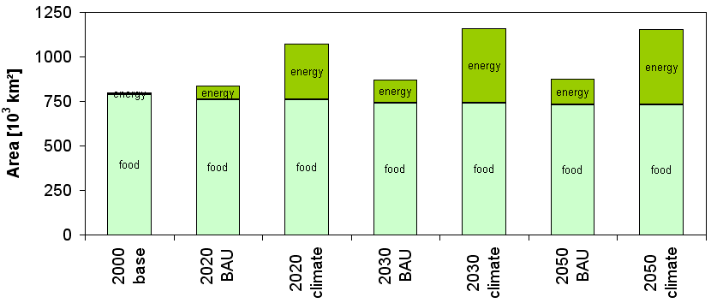
Total land requirement for crop production – upper bound

Slide 32
Emissions of CO₂ by sector (EU27)

Slide 33
Households and Trade and Commerce
Increasing electricity demand due to increasing use of electric and electronic devices and more air conditioning
Insulation leads to decreasing demand for heating
Reference: more gas, wood, solar thermal
Climate scenario: further enhanced insulation;
use of electric and gas heat pumps;
to less extent use of heat from decentralised CHP plants using gas

Slide 34
Industry
Processes (production of iron & steel, cement, paper and chemicals) cause highest energy demand
Step 1: improve efficiency, use waste heat
Step 2: change processes (e.g. electric arc furnace for iron & steel, dry processes for clincer production);
from 2030 on CCS
leads to increasing electricity demand

Slide 35
From activities to emissions

Slide 36
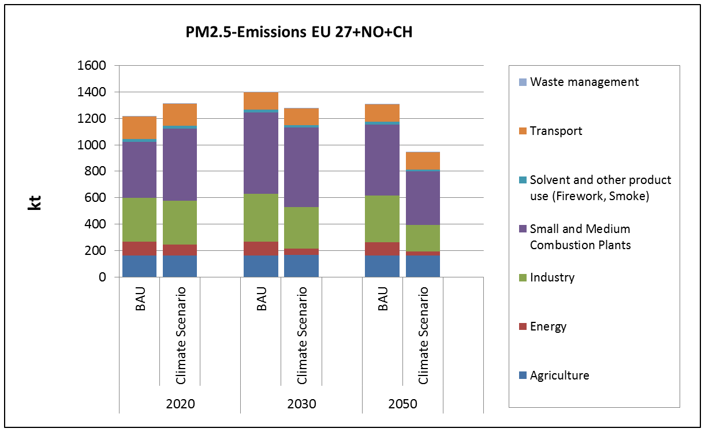
PM2.5-Emissions by Source Category for EU 29
36
Notes:
36

Slide 37
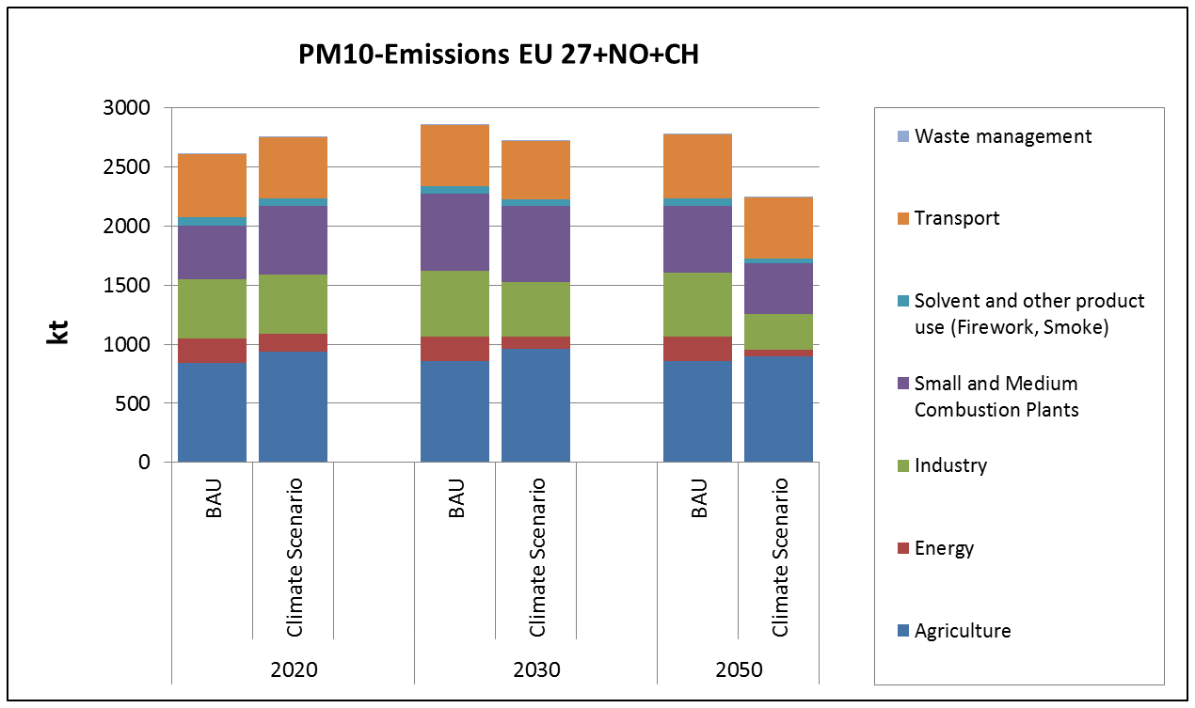
PM10-Emissions by Source Category for EU 29
37
Notes:
37

Slide 38
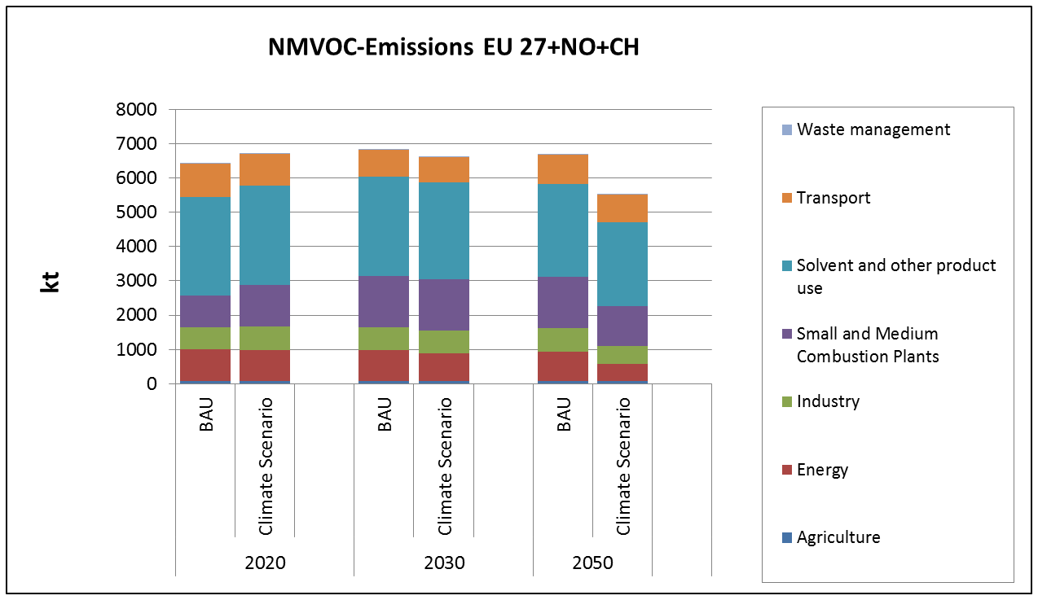
Results of Case Study
NMVOC-Emissions by Source Category for EU 29
EU 29: EU27+Switzerland and Norway
38
Notes:
38

Slide 39
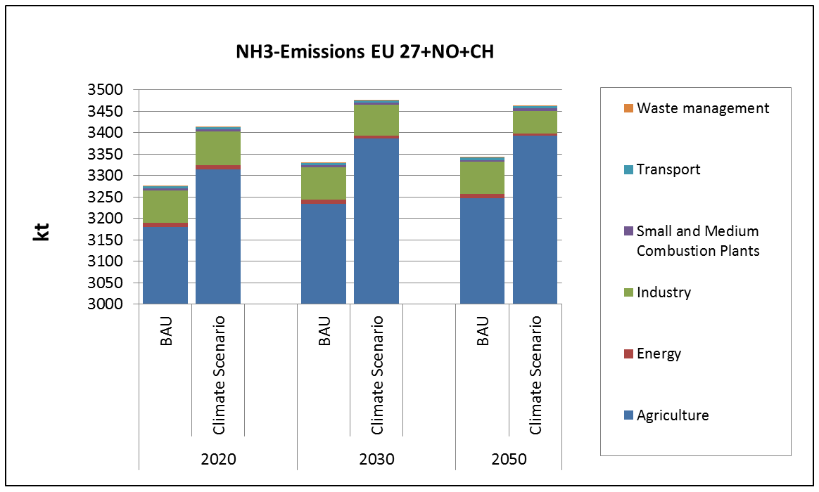
NH₃-Emissions by Source Category for EU 29 (Note: scale starts at 3000 kt)
39
Notes:
39

Slide 40
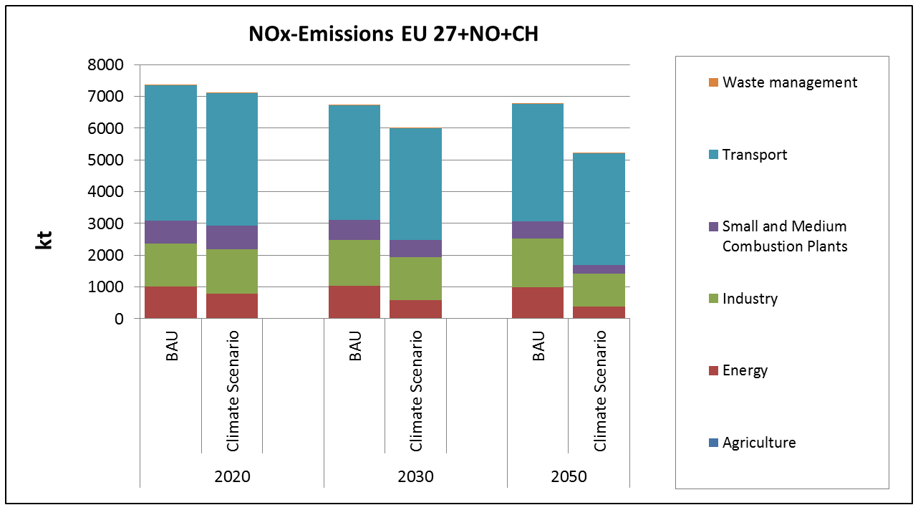
NO_{x}-Emissions by Source Category for EU 29
40
Notes:
40

Slide 41
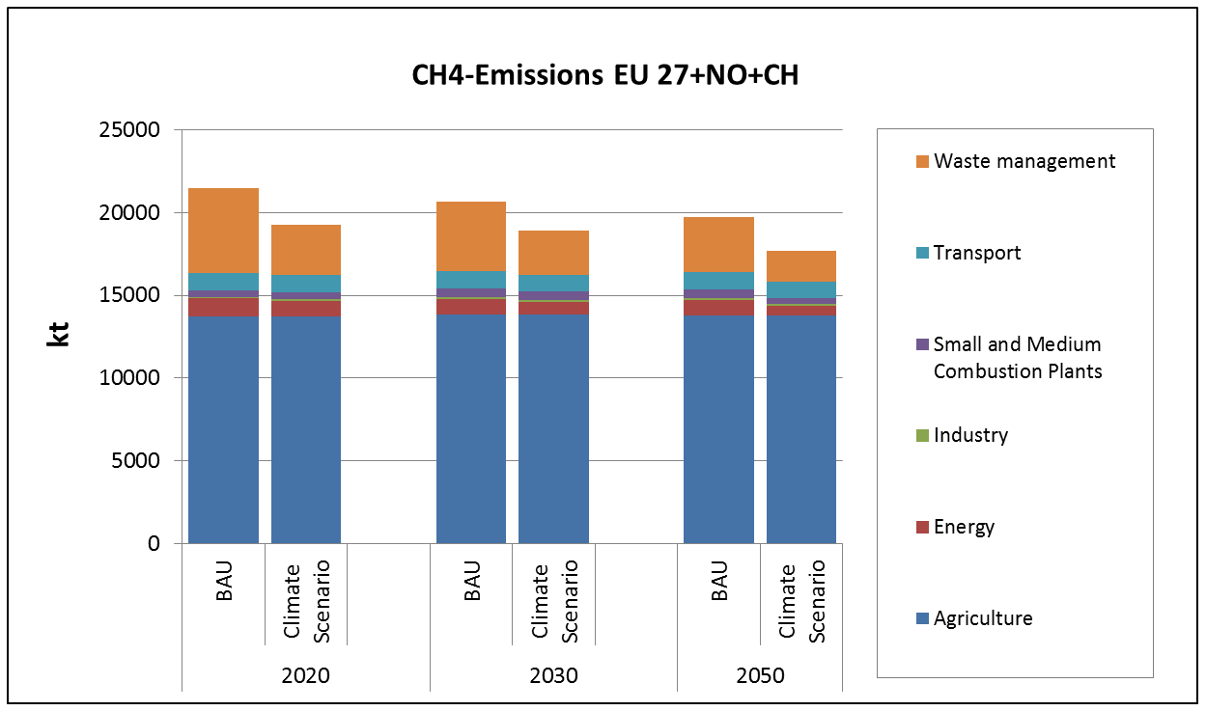
CH₄-Emissions by Source Category for EU 29
EU 29: EU27+Switzerland and Norway
41
Notes:
41

Slide 42
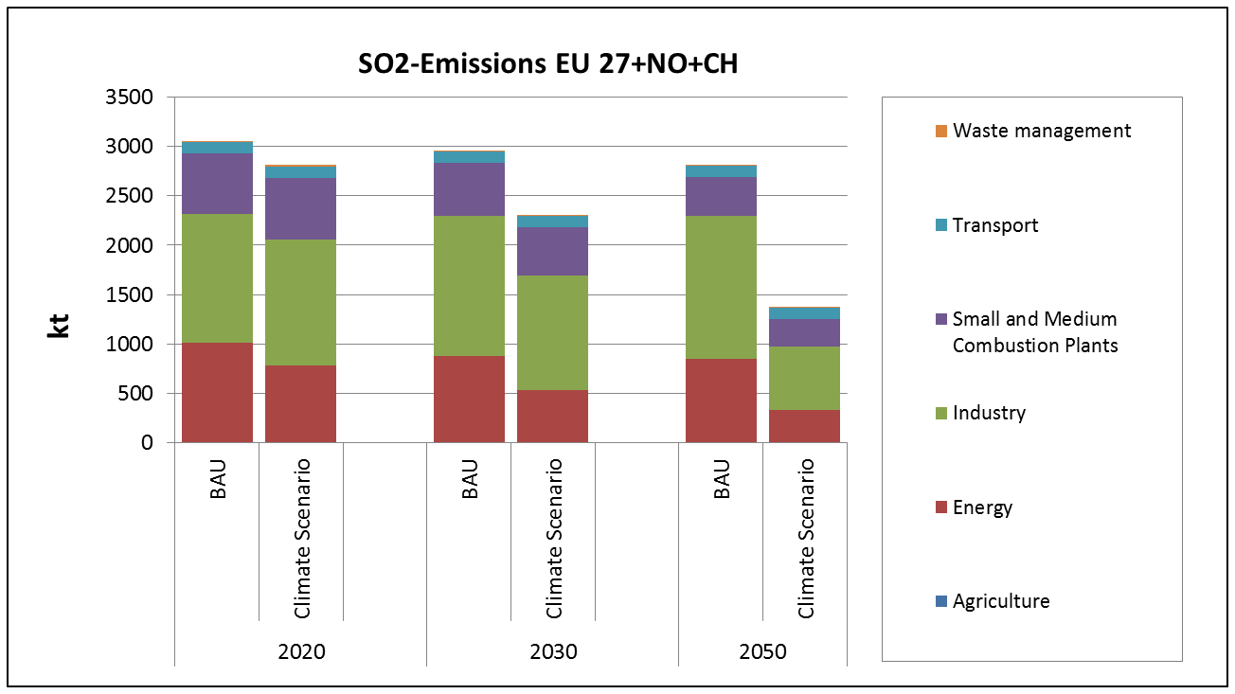
SO₂-Emissions by Source Category for EU 29
42
Notes:
42

Slide 43
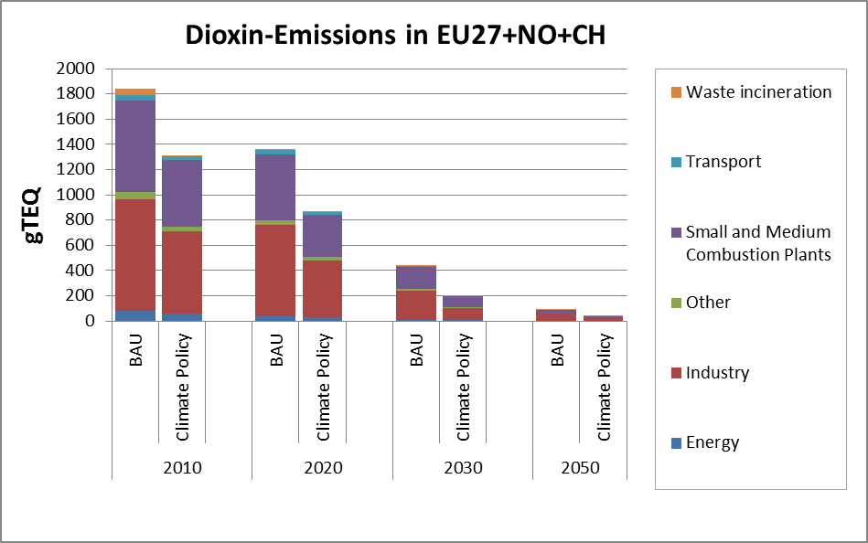

Slide 44
From emissions to concentrations/levels/intake/exposures
Used models:
Outdoor air: EMEP, Polyphemus, Chimere, ECOSENSE (parametrized), MSC-EAST (POPs, fertilizers)
New tool for assessing local impacts of pesticide application
Urban increment: new ‘urban increment estimation tool‘
Multimedia to food: new multimedia models dynamiCROP (pesticides), PANGEA (POP)
Noise: new noise upscaling model
Indoor: Steady state mass balance model with homogenous mixing
Exposure: new LAMA model

Slide 45
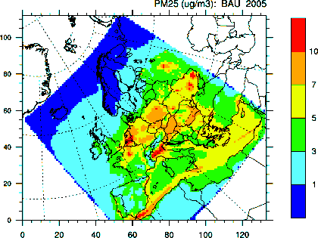
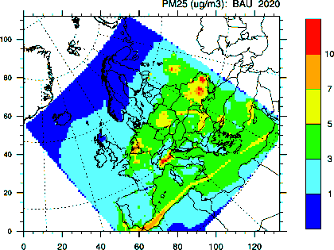
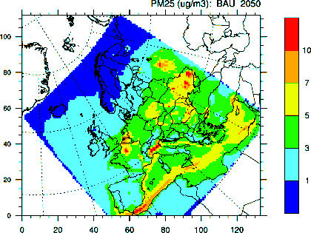
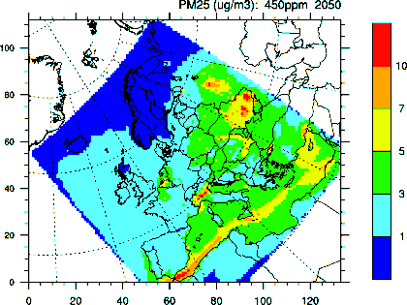
Concentration fields – Unified EMEP model
Calculated concentrations of PM_{2.5} in 2005, 2020 and 2050 for BAU scenario, and in 2050 for climate policy scenario

Slide 46
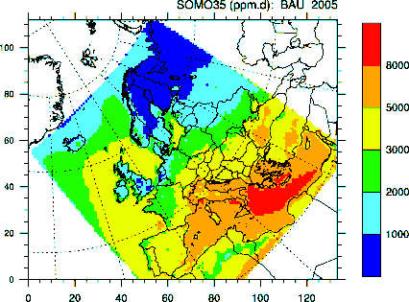
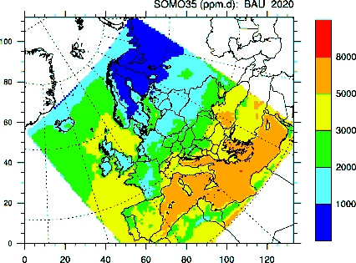
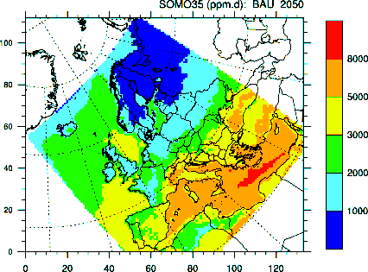
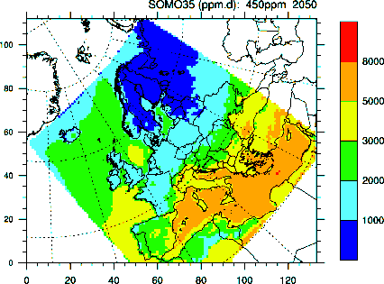
Concentration fields – Unified EMEP model
Calculated concentrations of SOMO35 in 2005, 2020 and 2050 for BAU scenario, and in 2050 for climate policy scenario

Slide 47
Comparison EMEP – Polyphemus - EcoSense
Scenario climate protection minus bau
2020

Slide 48

Pollutant Concentration in µg/m³
The typically higher pollutant levels in urban areas for most pollutants can be referred as urban increment, i.e., the difference between regional and urban background pollutant concentrations
Urban background
Rural background

Slide 49
Urban increment (PM2.5)
developed by Torras Ortiz (2010), USTUTT
where
C_{i} urban = Urban increment of pollutant i.
E_{iUE} = Total emission of pollutant i within the urban entity in tons.
A_{UE} = Urban entity area in km².
u_{avg} = Urban entity average wind speed in m/s.
C_{i rural} = Rural background concentration of pollutant i in µg/m³
ω_{i}, φ_{i}, and γ_{i} = Multiple-regression parameters for pollutant i.
Torras Ortiz, S. (2010). "A hybrid dispersion modelling approach for quantifying and assessing air quality in Germany with focus on urban background and kerbside concentrations," submitted Doctoral Thesis, University of Stuttgart, Stuttgart.

Slide 50
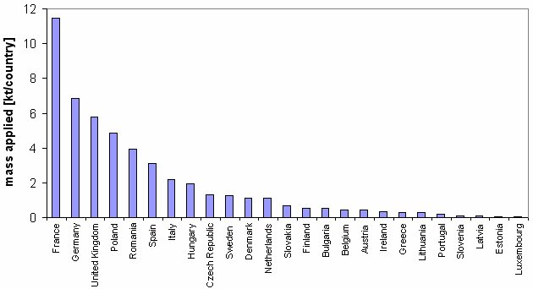
Use of pesticides
Amount of pesticides applied per country in the REF scenario

Slide 51
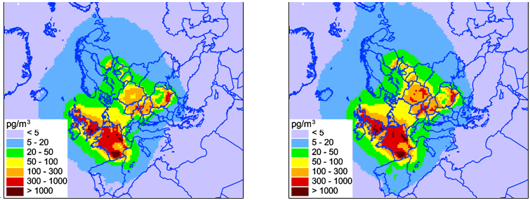
Pesticide Atmospheric Modeling
Air concentration, trifluralin
2020 BAU 2020 2° aim

Slide 52
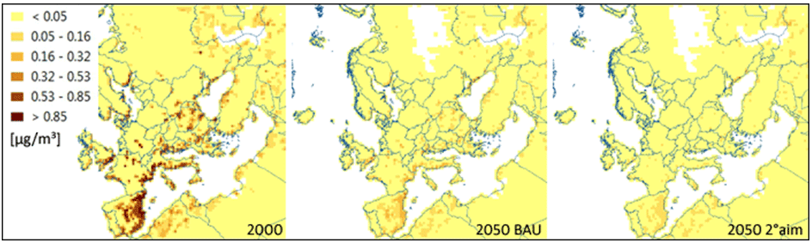
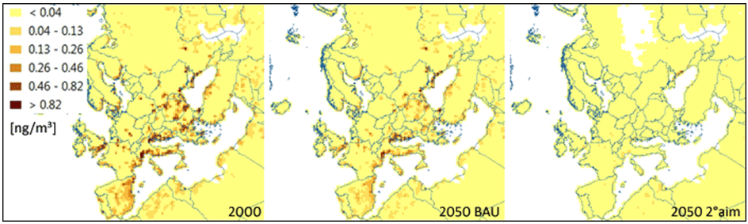
POPs Multimedia Fate Modeling (PANGEA)
Agricultural land concentration, 4PeCDF
Agricultural land concentration, PCB-153

Slide 53
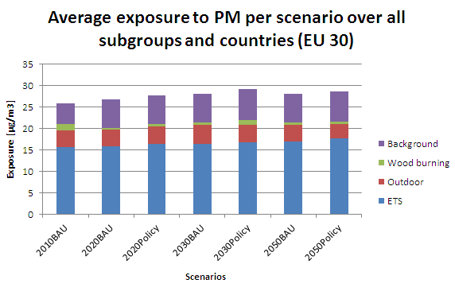
Personal exposure – Results

Slide 54
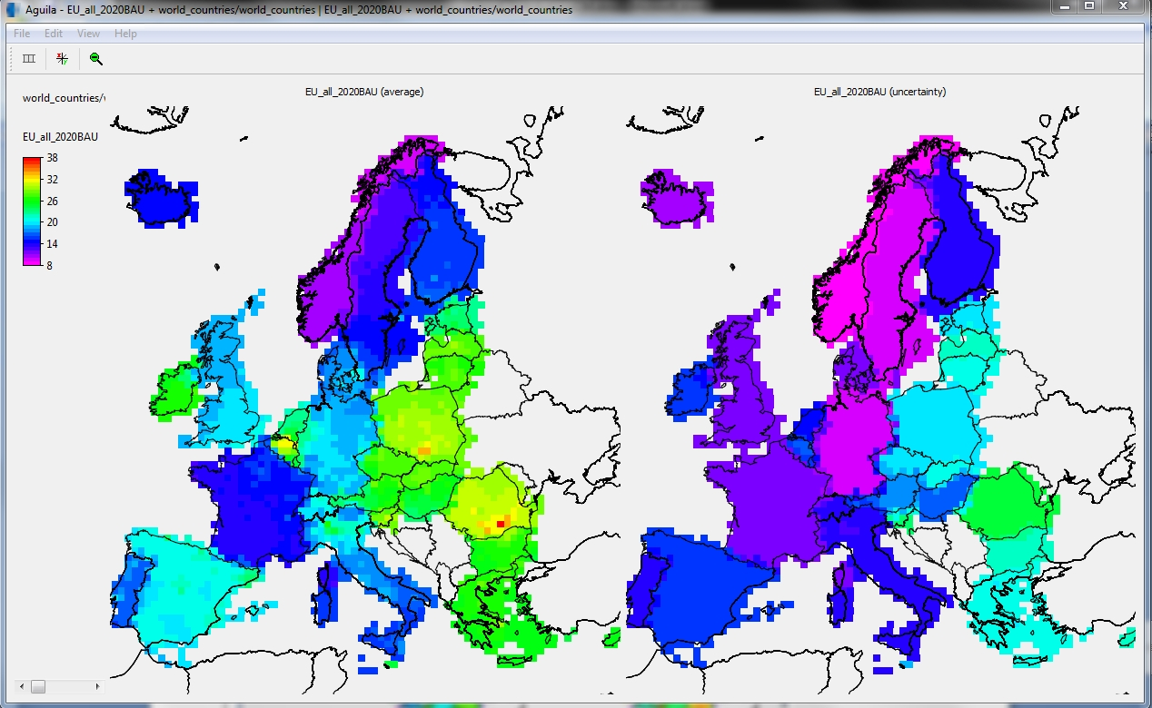
Average PM2.5 exposure results and uncertainty (standard deviation)
for 2020BAU scenario on the EMEP grid shown with the Aguila software

Slide 55
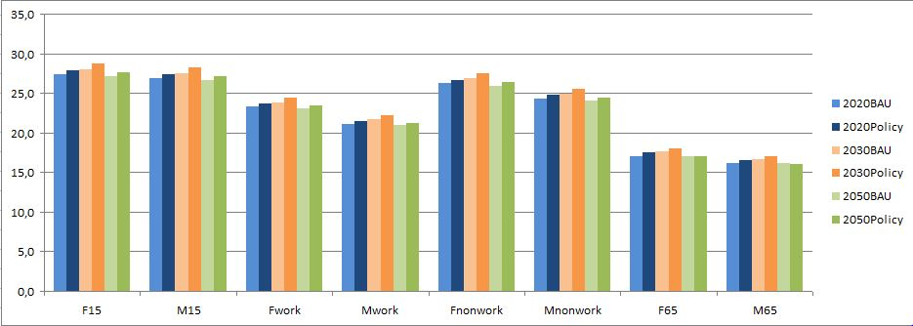
Average PM2.5 exposure over EU-30 per subgroup for the six scenarios:
behaviour of subgroups more important for health than outdoor PM reduction

Slide 56
From concentrations/levels/intake/exposures to health impacts/DALYs/monetary values

Slide 57
Air pollutants: Impact functions PM_{2.5}
Health effect | Relative Risk | Age Group | Population | Impact Function
PM2.5
Mortality (all cause) | 6% (95% CI: 2%, 11%) change per 1 μg/m³ PM_{2.5} | Adults 30 years and older | General Population | 101.4 YOLLs additional years of life lost per 1 μg/m³ increase in PM_{2.5} per 100,000 people aged 30+ in the general population per year
Work loss days (WLDs) | 4.6% (95% CI: 3.9%, 5.3%) increase per 10 μg/m³ PM_{2.5} | 15-64 Years | General Population | 20,700 (95% CI: 17,600, 23,800) additional work lost days per 10 μg/m3 increase in PM2.5 per 100,000 people aged 15-64 in the general population per year
Minor Restricted Activity Days (MRADs) | 7.4% (95% CI: 6.0%, 8.8%) change per 10 μg/m³ PM_{2.5} | 18-64 Years | General Population | 57,700 (95% CI: 46,800, 68,600) additional MRADs per 10 μg/m3 increase in PM2.5 per 100,000 adults aged 18-64 (general population) per year
Restricted activity days (RADs) | 4.75% (95% CI: 4.17%, 5.33%) change per 10 μg/m³ PM_{2.5} | 18-64 Years | General Population | 90,200 (95% CI: 79,200, 101,300) additional RADs per 10 μg/m3 increase in PM2.5 per 100,000 adults aged 18-64 (general population) per year

Slide 58
Pesticide DRFs
Dose-response relationships: carcinogenicity for selected pesticides via food (50% fatality)
Target Class | Substance Name | Slope Factor [life-time cancer risk per mg intake per kg body and day]
Fungicides | Carbendazim | 0.00239
 | Chlorothalonil | 0.00766
 | Iprodione | 0.0439
Herbicides | Bromoxynil | 0.103
 | Isoxaflutole | 0.0102
 | Molinate | 0.11
 | Propyzamide | 0.0259
 | Tralkoxydim | 0.0168
 | Trifluralin (only for evaluation) | 0.00293

Slide 59
Air pollutants: Impact functions PM₁₀
Health effect | Relative Risk | Age Group | Population | Impact Function
PM10
Infant Mortality | 4% (95% CI: 2%, 7%) change per 10 ug/m3 PM10 | 1 month to 1 year | General Population | 5.8 (95% CI: 2.9, 10.2) additional infant deaths per 10 μg/m3 PM10 per 100,000 live births, per year
Chronic bronchitis | 22% (95% CI: 2%, 38%) change per 10 μg/m3 PM10 | Adults aged 18 years and older | General Population without symptoms (90% of population) | 86 (95% CI 7.8, 150) new cases per 10 μg/m3 PM10 per 100,000 adults aged 18 and older, per year
Cardiovascular hospital admissions | 0.6% (95% CI: 0.3%, 0.9%) change per 10 μg/m3 PM10 | All Ages | General Population | 4.3 (95% CI: 2.2, 6.5) additional emergency cardiac hospital admissions per 10 μg/m3 increase in PM10 per 100,000 people (all ages) per year
Respiratory hospital admissions | 0.9% (95% CI: 0.7%, 1.0%) change per 10 μg/m3 PM10 | All Ages | General Population | 5.6 (95% CI: 4.3, 6.2) additional emergency respiratory hospital admissions per 10 μg/m3 increase in PM10 per 100,000 people (all ages) per year

Slide 60
Air pollutants: Impact functions PM₁₀
Health effect | Relative Risk | Age Group | Population | Impact Function
PM10
Asthma medication use (children aged 5-14) | 0.4% (95% CI: ­1.7%, 2.6%) change per 10 μg/m3 PM10 | 5-14 Years | Children with Asthma (14.4% of children aged 5-14 in EU27 have asthma) | 14,600 (95% CI: ­62,050, 94,900) additional days of bronchodilator usage per 10 ug/m3 increase in PM10 per 100,000 children aged 5-14 years meeting the PEACE study criteria, per year
Bronchodilator usage in adults (aged 20 and older) with asthma | 0.5% (95% CI: ­0.5%, 1.5%) change per 10 μg/m3 PM10 | Adults aged 20 years and older | Adults with asthma (10.2% of adults aged 20+ in EU27 have asthma) | 91,300 (95% CI: ­91,300, 274,000) additional days of bronchodilator usage per 10 μg/m3 increase in PM10 per 100,000 adults aged 20 and older with well-established asthma, per year
Lower respiratory symptoms incl.cough among children | 3.4% (95% CI: 1.7%, 5.1%) change per 10 μg/m3 PM10 | 5-14 Years | General Population | 186,000 (95% CI: 93,100, 279,000) additional symptom days per 10 μg/m3 increase in PM10 per 100,000 children aged 5-14, per year
LRS (including cough) in symptomatic adults | 1.2% (95% CI: 0.1%, 2.2%) change per 10 μg/m3 PM10 | Adults | Adults with chronic resp. symptoms (30%) | 131,000 (95% CI: 11,000, 241,000) additional symptom days per 10 μg/m3 increase in PM10, per 100,000 adults with chronic respiratory symptoms, per year

Slide 61
Air pollutants: Impact functions Ozone
Health effect | Relative Risk | Age Group | Population | Impact Function
Ozone
Mortality (all cause) | 0.3% (95% CI: 0.1%, 0.4%) change per 10 μg/m3 O3 | All Ages | General Population | 2.8 (95% CI: 0.92, 3.7) additional deaths (or life years lost) per 10 μg/m3 increase in O3 per 100,000 population (all ages), per year
Respiratory hospital admissions (adults aged 65+) | 0.5% (95% CI: ­0.2%, 1.2%) change per 10 μg/m3 O3 (8-hr daily average) | Adults aged 65 years and older | General Population | 12.5 (95% CI: ­5.0, 30.0) additional emergency respiratory hospital admissions per 10 μg/m3 increase in O3 per year per 100,000 people aged 65+, per year
Bronchodilator usage in children (general population) | 21% (95% CI: 2.9%, 39%) change per 10 ug/m3 O3 | 5-14 Years | General Population | 24,500 (95% CI: 3,400, 45,600) additional days of bronchodilator usage per 10 μg/m3 increase in O3 per 100,000 children aged 5-14 (general population), per year
Bronchodilator use in adults (aged 20 and older) with asthma | 0.6% (95% CI: ­0.2%, 1.4%) change per 10 ug/m3 O3 | Adults aged 20 years and older | Adults with asthma (10.2% of adults in EU27 have asthma) | 70,100 (95% CI: ­23,400, 164,000) additional days of bronchodilator usage per 10 ug/m3 increase in O3 per 100,000 adults aged 20 and older with persistent asthma, per year

Slide 62
Air pollutants: Impact functions Ozone
Health effect | Relative Risk | Age Group | Population | Impact Function
Ozone
Lower respiratory symptoms (LRS) (excluding cough) among children in general population (5-14) | 3.0% (95% CI: ­7.9%, 15%) change per 10 μg/m3 O3 | 5-14 Years | General Population | 16,000 (95% CI: ­43,000, 82,000) additional days of LRS (excluding cough) per 10 μg/m3 increase in O3 per 100,000 children aged 5-14 years, per year
Cough (days) among children in the general population (5-14) | 4.7% (95% CI: ­0.9%, 11%) change per 10 μg/m3 O3 | 5-14 Years | General Population | 93,000 (95% CI: ­17,700, 217,000) additional cough days per 10 μg/m3 increase in O3 per 100,000 children aged 5-14 years per year
Minor Restricted Activity Days (MRADs) | 1.48% (95% CI: 0.57%, 2.38%) change per 10 μg/m3 O3 | 18-64 Years | General Population | 11,500 (95% CI: 4,400, 18,600) additional MRADs per 10 μg/m3 increase in O3 per 100,000 adults aged 18-64 (general population) per year

Slide 63
DALYs: duration in fraction of year, DALY= weight*duration,
endpoint | weight | duration
Bronchodilator Usage Adults and Children | 0.22 | 0.00274
Cardiac Hospital Admissions | 0.71 | 0.038
Chronic Bronchitis | 0.099 | 10
Infant Mortality | 1 | 80
Lower Respiratory Symptoms Adults and Children | 0.099 | 0,00274
Respiratory Hospital Admissions | 0.64 | 0.038
Minor Restricted Acitvity Day | 0.07 | 0.00274
Restricted Acitvity Day | 0.099 | 0.00274
Work Loss Day | 0.099 | 0.00274
Years Of Life Lost chronic. Mortality | 1 | 1
Cough Days | 0.07 | 0.00274
Lower Respiratory Symptoms Children Excl Cough | 0.099 | 0.00274
Respiratory Hospital Admissions | 0.64 | 0.038

Slide 64
Monetary values of health endpoints (EUR 2010)
Health End-Point | Low | Central | High | per case
Increased mortality risk - VSLacute | 1,121,433 | 1,121,433 | 5,607,164 | Euro
Life expectancy reduction - Value of Life Years chronic | 37,500 | 60,000 | 215,000 | Euro
Increased mortality risk - infants | 1,120,000 | 2,475,000 | 11,200,000 | Euro
Sleep disturbance | 480 | 1,240 | 1,570 | Euro/year
Hypertension | 880 | 950 | 1,110 | Euro/year
Acute myocardial infarction | 4,675 | 86,200 | 436,200 | Euro
Lung cancer | 69,080 | 719,212 | 4,187,879 | Euro
Leukaemia | 2,045,493 | 3,974,358 | 7,114,370 | Euro
Neuro-development disorders | 4,486 | 14,952 | 32,895 | Euro
Skin cancer | 10,953 | 13,906 | 26,765 | Euro
Osteoporosis | 2,990 | 5,682 | 8,074 | Euro
Renal dysfunction | 22,788 | 30,406 | 40,977 | Euro
Anaemia | 748 | 748 | 748 | Euro

Slide 65
Air pollutants – monetary values (EUR 2010)
Health End-Point | Central | per case
New cases of chronic bronchitis | 60,000 | Euro
Increased mortality risk - Value Of Life Years | 89,715 | Euro
Respiratory hospital admissions | 2,990 | Euro
Cardiac hospital admissions | 2,990 | Euro
Work loss days (WLD) | 441 | Euro
Restricted activity days (RADs) | 194 | Euro
Minor restricted activity days (MRAD) | 57 | Euro
Lower respiratory symptoms | 57 | Euro
LRS excluding cough | 57 | Euro
Cough days | 57 | Euro
Medication use / bronchodilator use | 80 | Euro

Slide 66
emissions
Gt

Slide 67
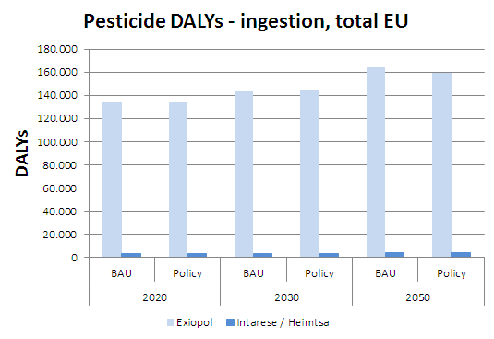
Pesticide DALYs – ingestion, total EU
Exiopol: non-cancer effects; Heimtsa / Intarese: cancer effects
Different assumptions and different pesticides for both projects!

Slide 68
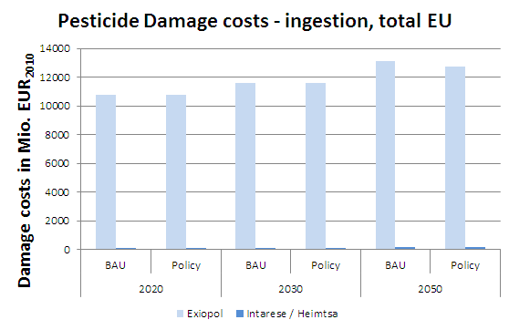
Pesticide Damage Costs – ingestion, total EU
Exiopol: non-cancer effects; Heimtsa / Intarese: cancer effects
Different assumptions and different pesticides for both projects!

Slide 69
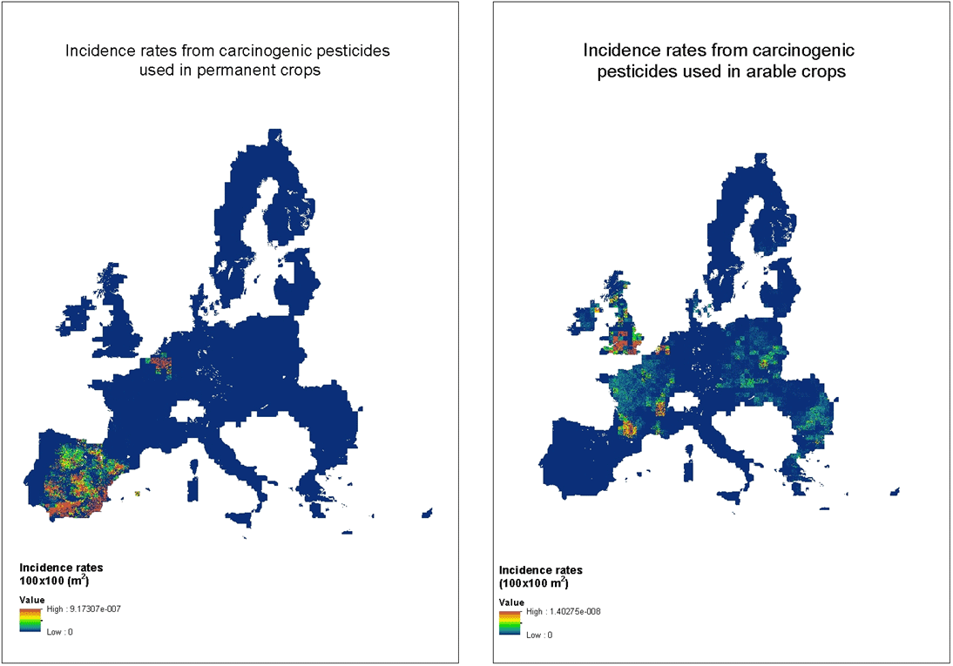
DALYs due to inhalation of pesticides, local effects (farmers), cancers only
Total DALY EU: Total DALY EU:
~18.3 x 10⁻³ ~0.5 x 10⁻³

Slide 70
Pesticide DALYs – inhalation, general public
DALYs (inhalation of general public after dispersion modelling, trifluralin as test chemical, cancers only)
Assuming inhalation rate of 20 m³/day per person
< 6.5 DALY in Europe in 2000 baseline scenario due to inhalation of trifluralin
Comparison with ingestion exposure:
< 2500 DALY in Europe in 2000 baseline scenario due to ingestion of trifluralin via ingestion
ingestion is by far the most important health impact of pesticides

Slide 71
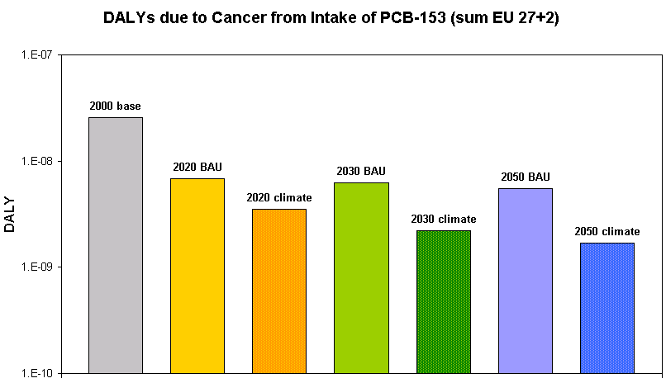
DALYs due to PCB-153 – total EU

Slide 72
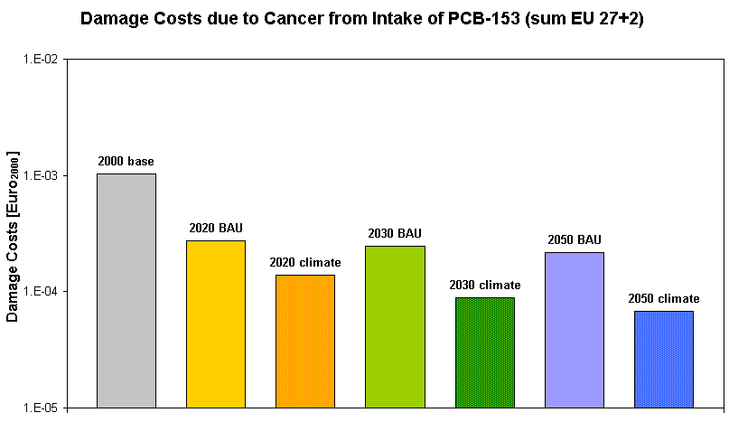
Damage Costs of PCB-153 – total EU
( non-dioxin like PCBs show other health effects than PCB-153, but so far not quantified)

Slide 73
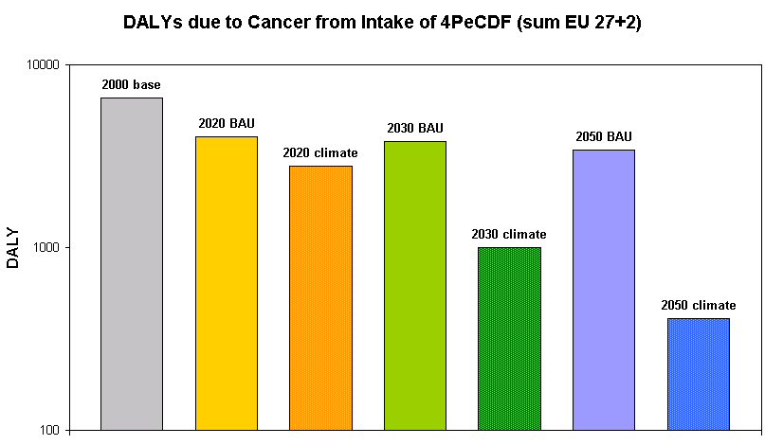
DALYs due to 2,3,4,7,8-PeCDF – EU29
For 4pentaclorodibenzofuran,
impacts from all dioxins and furanes ca. 2,5 times higher

Slide 74
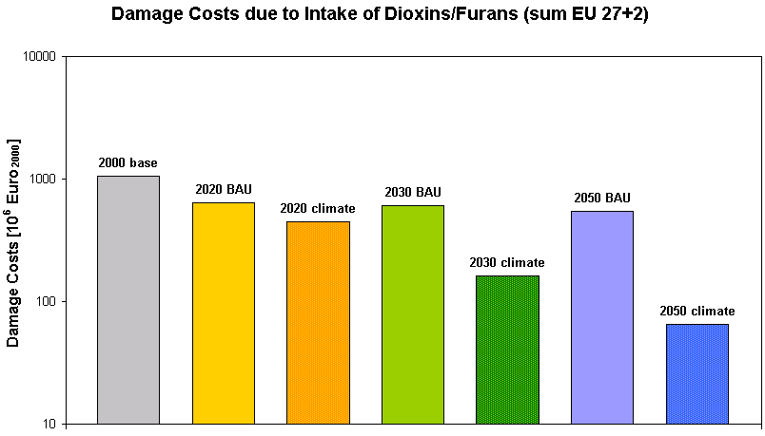

Slide 75
Heat stress (1000 DALYs/a)
 | 2010 | 2030 | 2050
Reference | 75 (7 - 174) | 210 (19 - 495) | 400 (38 - 932)
2° scenario | 75 (7 - 174) | 196 (18 - 458) | 237 (21 - 583)
difference |  | 14 | 163

Slide 76
Heat stress (1000 premature deaths/a)
 | 2010 | 2030 | 2050
Reference | 14,6 (8-23) | 41,2 (22-67) | 78,4 (42-123)
2° scenario | 14,6 (8-23) | 38,4 (21-61) | 46,3 (24-77)
difference |  | 2,8 | 32,1

Slide 77
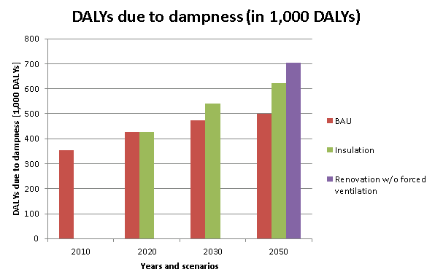
Mould - dampness DALYs in the EU 30

Slide 78
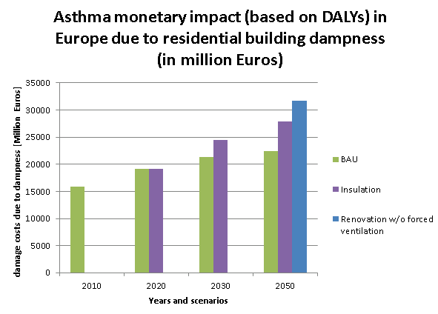
Mould - dampness (1000M€ = ca. 17 000 DALYs)

Slide 79
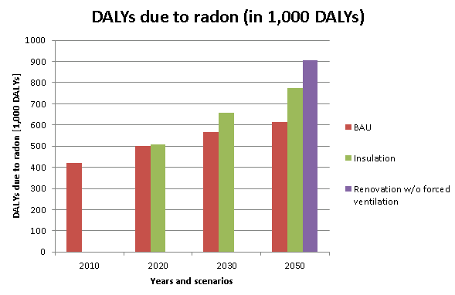
Radon – DALYs in the EU 30

Slide 80
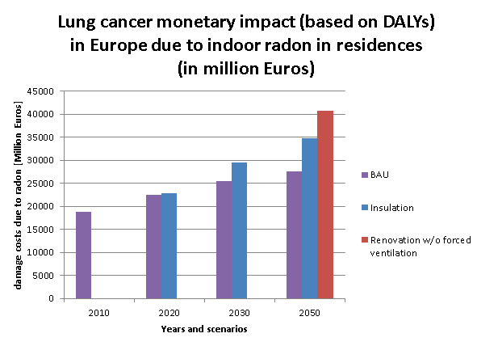
Radon

Slide 81
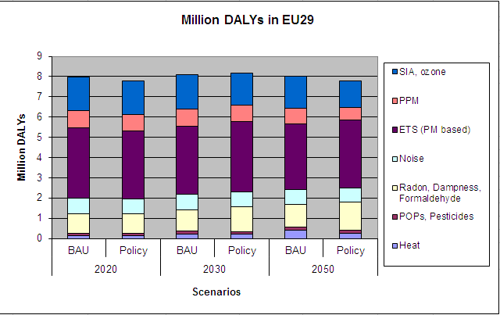
DALYs due to all stressors for all scenarios
1
1
2
1 If no additional measures to improve air exchange rate in buildings are implemented.
2 Results from the Exiopol project.

Slide 82
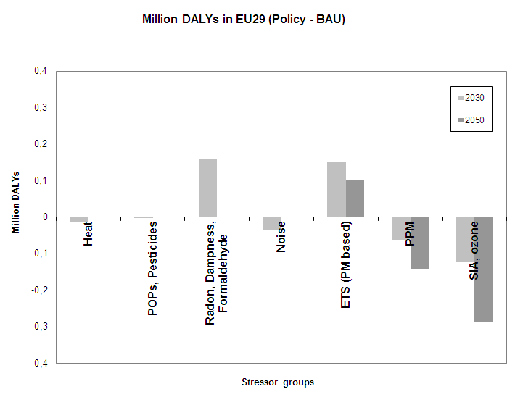
Differences: Policy – BAU (DALYs)

Slide 83
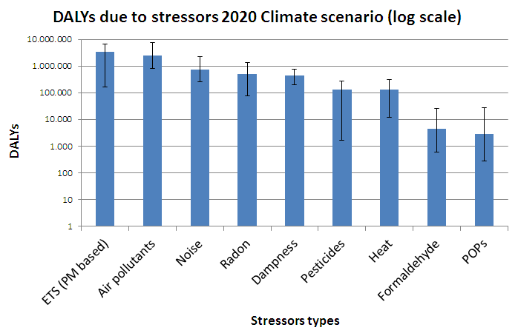
DALYs due to all stressors for 2020 Climate
1
1
1
2
1 If no additional measures to improve air exchange rate in buildings are implemented.
2 Results from the Exiopol project.

Slide 84
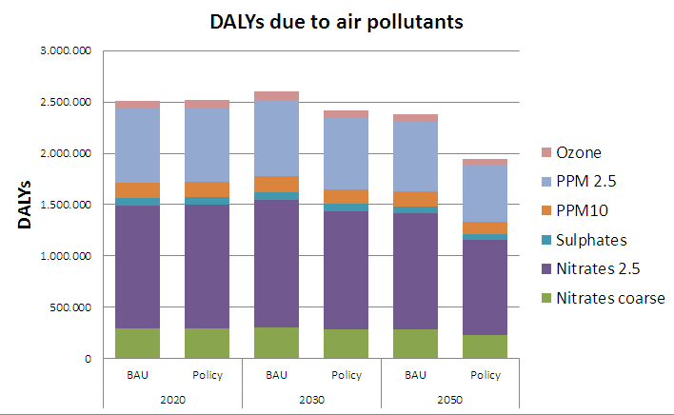
DALYs due to outdoor air pollutants

Slide 85
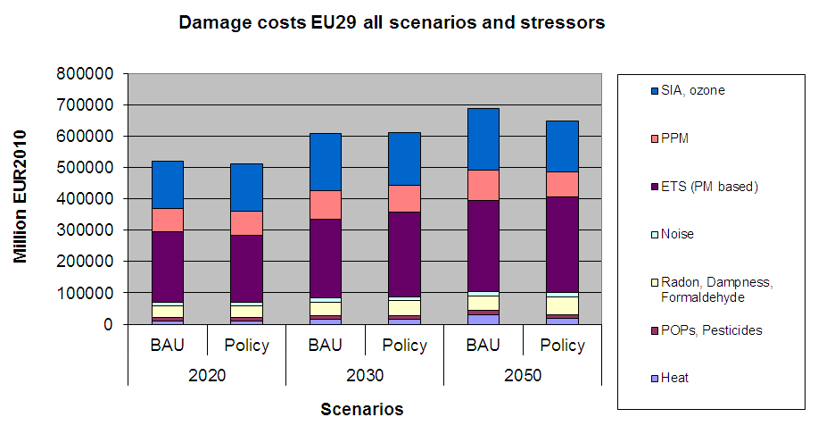
Damage costs due to all stressors (all scenarios)
1
1
2
1 If no additional measures to improve air exchange rate in buildings are implemented.
2 Results from the Exiopol project.

Slide 86
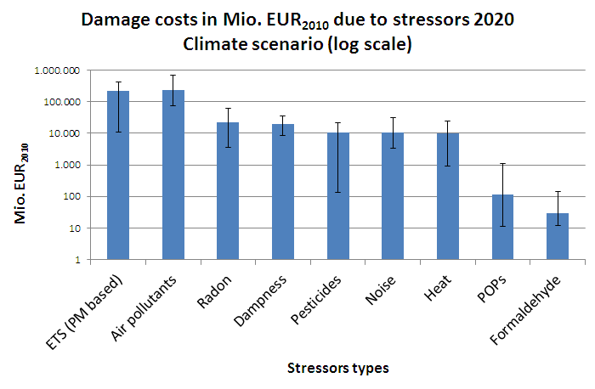
Damage costs for 2020 Climate scenario
1
1
1
2
1 If no additional measures to improve air exchange rate in buildings are implemented.
2 Results from the Exiopol project.

Slide 87
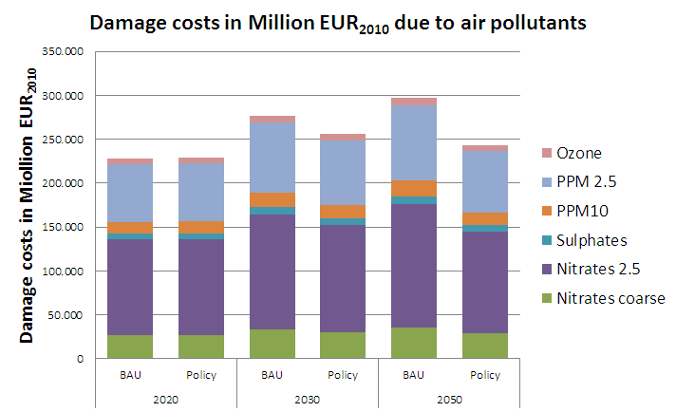
Damage costs due to outdoor air pollutants

Slide 88
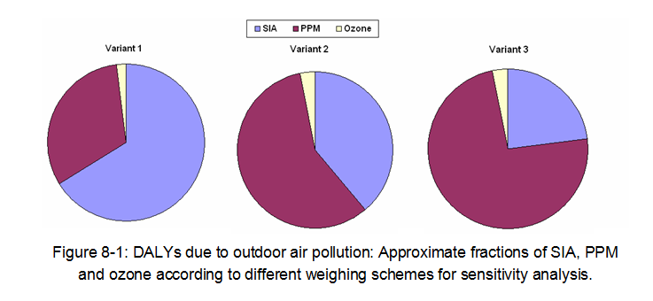
Air pollutants – sensitivity analysis
 | Scheme 1 | Scheme 2 | Scheme 3
PPM2.5 | 1 | * 1.5 | * 1.75
nitrates | 1 | * 0.5 | * 0.25
sulphates | 1 | * 0.6 | * 0.25
PPMcoarse | 1 | * 1 | * 1
nitratescoarse | 1 | * 0.5 | * 0.25
Scheme for weighing the health impacts of one unit of different content of particulate matter.
Share of

Slide 89
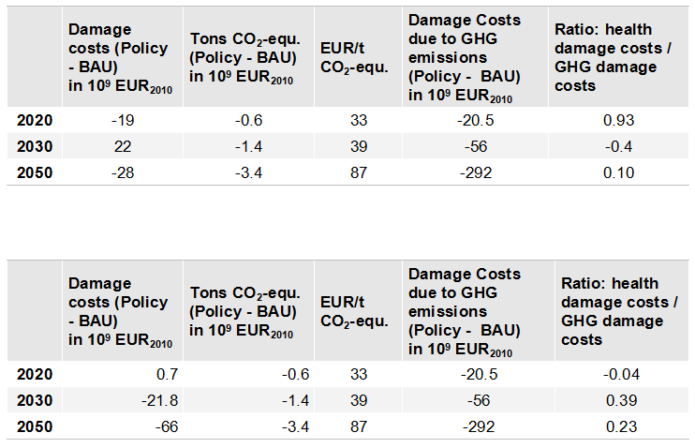
Comparison of CO₂-equ. and damage costs
-9
0.442
5
-0.09
-40
0.14
Avoided damage costs of health effects compared to avoided costs due to green house gas emissions in EU29 for the Policy scenario compared to the BAU scenario in the years 2020, 2030 and 2050. Above: all sources; below: excluding indoor sources

Slide 90
Avoided mDALYs / t avoided CO₂-equ.
with all sources
 | avoided DALYs | avoided t CO2-equ. | mDALY / ton CO2-euq.
2020 | 162,375 | 622,378,300 | 0.3
2030 | -73,861 | 1,437,840,680 | -0.05
2050 | 251,496 | 3,360,330,230 | 0.08
without indoor sources
 | avoided DALYs | avoided t CO2-equ. | mDALY / ton CO2-euq.
2020 | 19,165 | 622,378,300 | 0.03
2030 | 236,359 | 1,437,840,680 | 0.16
2050 | 636,267 | 3,360,330,230 | 0.19

Slide 91
-> Assessment of single measures embedded in full scenario is necessary

Slide 92
Assumptions for measure „insulation“
House types
  “Old”: penetration and infiltration as status quo (in each country)
  “New”: tighter houses; minimum hygienic air exchange rate ensured
  “Renovated”: tighter houses; very low air exchange rate
Percentage of house types per scenario (shown as EU average)
 | New | Renovated | Old
2050 BAU | 58 % |  | 42 %
2050 Policy | 81 % |  | 19 %
2050 Insulation | 40,5 % | 40,5 % | 19 %

Slide 93
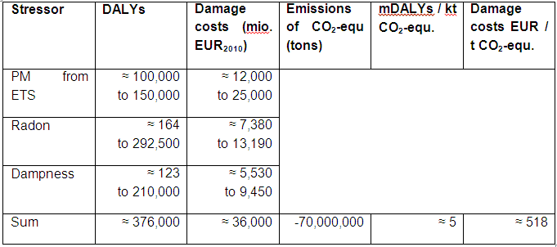
Insulation Scenario
Change (between insulation and BAU/Ref) in different metrics due to renovation (= additional DALYs and damage costs)
(effects due to ETS might be overestimated)

Slide 94
Agriculture 2030
Reduced cattle scenario:
(additional DALYs and damage costs)
Policy vs. BAU | 2030
Avoided CO₂-equ. [kt] | 13,000
Additional damage costs [million EUR₂₀₁₀] | 6,000
Add. EUR / t avoided CO₂-equ. | 460
Add. mDALY / t avoided CO₂-equ. | 8

Slide 95
Heat stress adaptation policies: avoided DALYs
 | 2020 | 2030 | 2050
BAU vegetation | 5,350 (494 – 12,254) | 9,160 (842 - 20,931) | 15,851 (1,536 – 36,460)
BAU albedo | 14,266 (1,315 – 32,717) | 23,888 (2,199 – 54,238) | 40,258 (3,910 – 92,309)
2° scenario vegetation | 6,093 (563 – 14,083) | 8,356 (767 – 18,907) | 9,744 (858 – 23,146)
2° scenario albedo | 15,805 (1,458 – 36,493) | 21,142 (1,926 – 48,154) | 25,120 (2,219 – 58,727)
95
/ 5

Slide 96
Single measures traffic 2020
96
/ 5

Slide 97
Single measures 2020 energy sector
97
/ 5

Slide 98
98
/ 5

Slide 99
Conclusions
  The impact of most climate change mitigation policies on environmental human health is nearly as important as the climate change effects.
  Some policies, especially biomass burning and reducing air exchange rates in houses, cause quite high additional health impacts.
  The analysis allows a ranking of stressors in environmental media with regard to overall health impacts:
  PM (and PM-based ETS) -> noise, radon -> ozone -> mould -> dioxins, heat waves-> pesticides -> PCBs
  In general: relevant ‘side effects’ will change policy recommendations substantially, should thus be taken into account when making decisions and can be taken into account using the IEHIA methodology
  More information: www.integrated-assessment.eu

